Slide 1

Consumer Goods AdHoc Insights
Presented by P K Aswin

Slide 2
Atliq’s Market and Related Information
Data,
Ad-Hoc Requests, Team and Tools
AGENDA
Introduction
Key Insights

Slide 3
INTRODUCTION
AtliqHardware is a leading computer hardware manufacturer in India, extending its influence to international markets. Despite its prominence, management acknowledges a lack of comprehensive insights hindering informed decision-making.
Atliq's market presence extends globally, encompassing regions across APAC, EU, LATAM, and NA.
To assess potential candidates thoroughly, Data Analytics Director Tony Sharma proposes conducting a SQL challenge to evaluate both technical proficiency and soft skills.
Furthermore, the company requires insights for ten ad hoc requests, emphasizing the need for data-driven decision-making across various operational aspects.

Slide 4
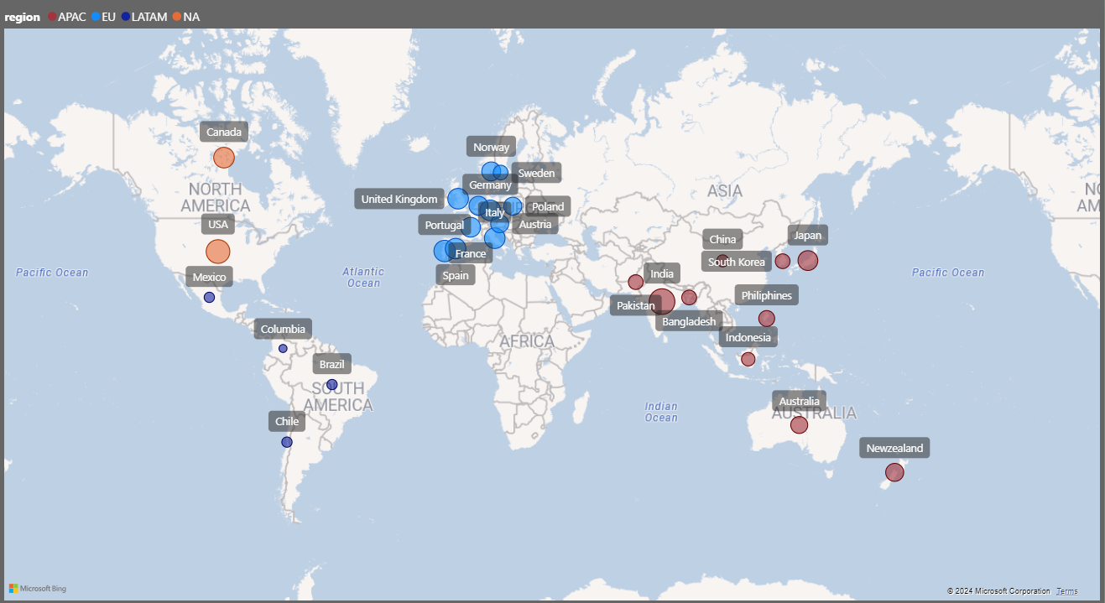
Atliq’s Global Market

Slide 5
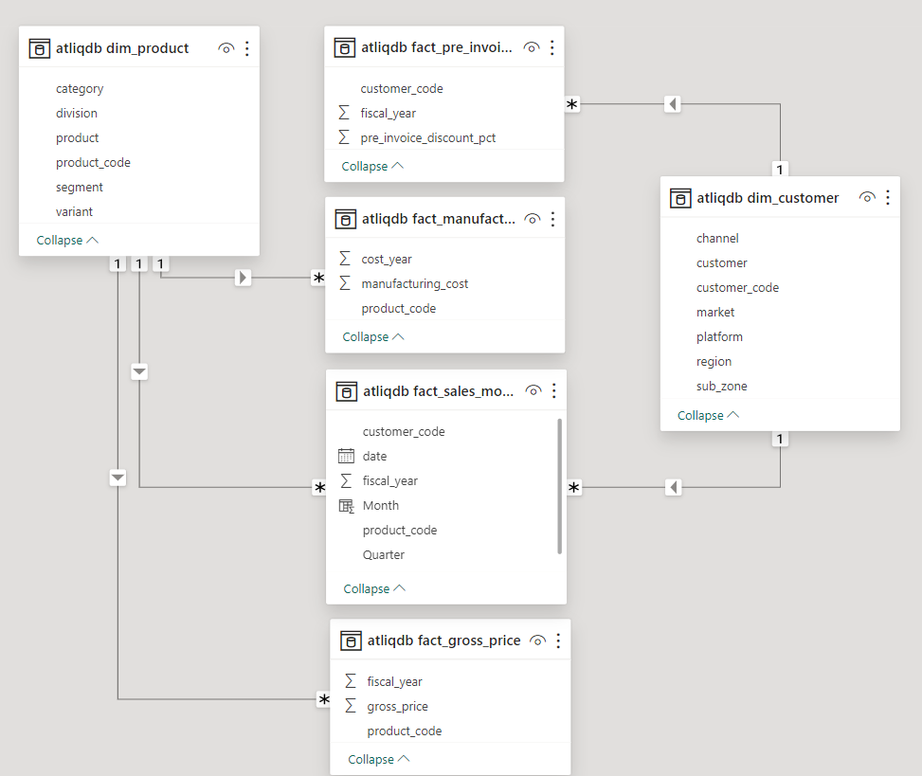
Data tables consists of Sales data for FY 2020 and FY 2021, customer details, product details, manufacturing details, price details etc.

Slide 6
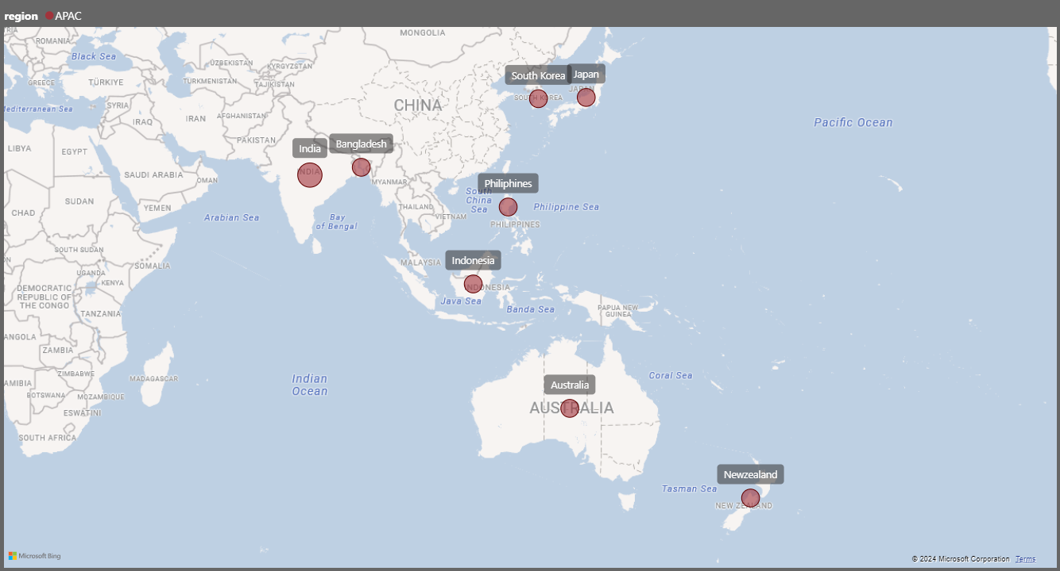
1.Provide the list of markets in which customer "Atliq Exclusive" operates its business in the APAC region.

Slide 7

2.What is the percentage of unique product increase in 2021 vs. 2020? The final output contains these fields:
unique_products_2020,
unique_products_2021,
percentage_change

Slide 8

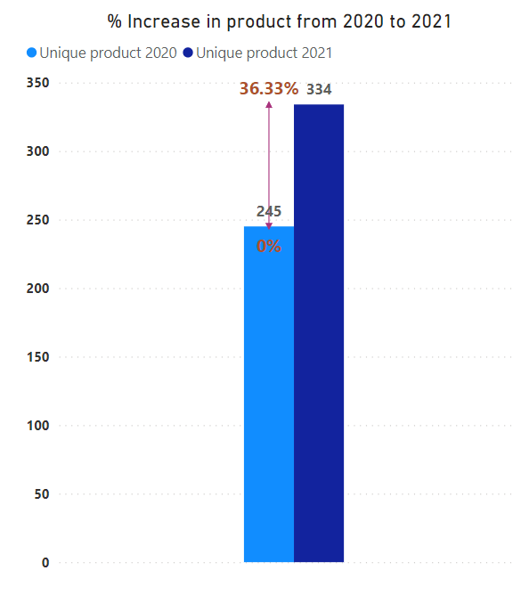
INSIGHTS:
1. Dynamic Innovation:The 36.33% increase in product count from FY 2020 to FY 2021 (245 to 334 products) indicates a proactive stance towards innovation, enabling the company to continually refresh its offerings and stay competitive in evolving markets.
2. Aligned Growth: reflecting a synchronized approach to growth and market responsiveness.

Slide 9
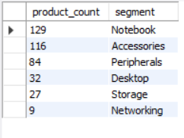
3.Provide a report with all the unique product counts for each segment and sort them in descending order of product counts. The final output contains 2 fields: Segment,
product_count

Slide 10
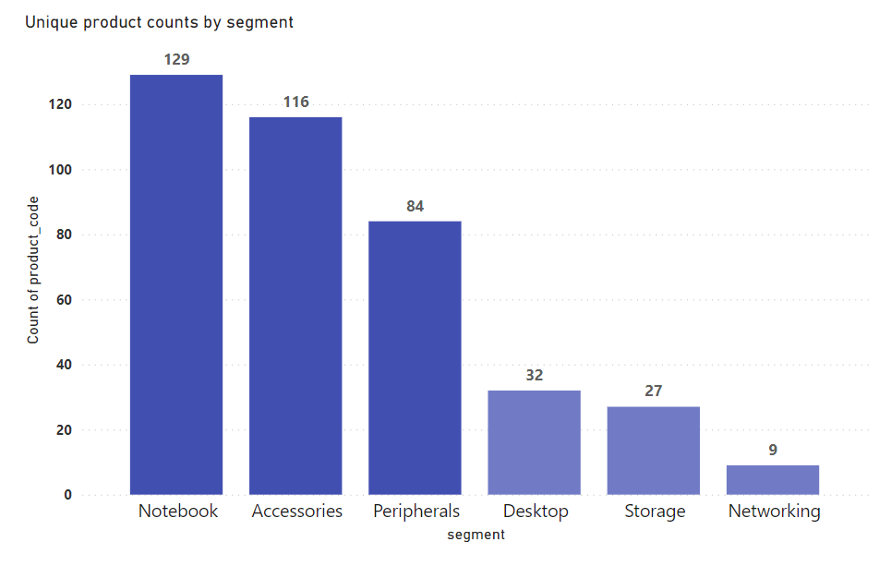
INSIGHTS:
1. While segments like Notebooks, Peripherals, and Accessories boast an average of 110 products each, indicating substantial manufacturing activity, segments like Desktops, Networking, and Storage lag behind with only around 23 products on average, highlighting the need for diversification in these areas.
2. The manufacturing growth in segments such as Notebooks, Accessories, and Peripherals is pronounced, with these segments collectively constituting 83% of the total manufactured products, underlining their significant contribution to overall manufacturing output compared to Desktops, Storage, and Networking segments.

Slide 11
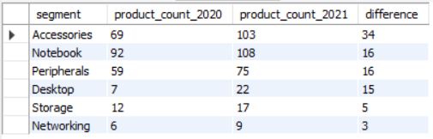
4.Follow-up: Which segment had the most increase in unique products in 2021 vs 2020? The final output contains these fields:
segment,
product_count_2020,
product_count_2021,
difference

Slide 12
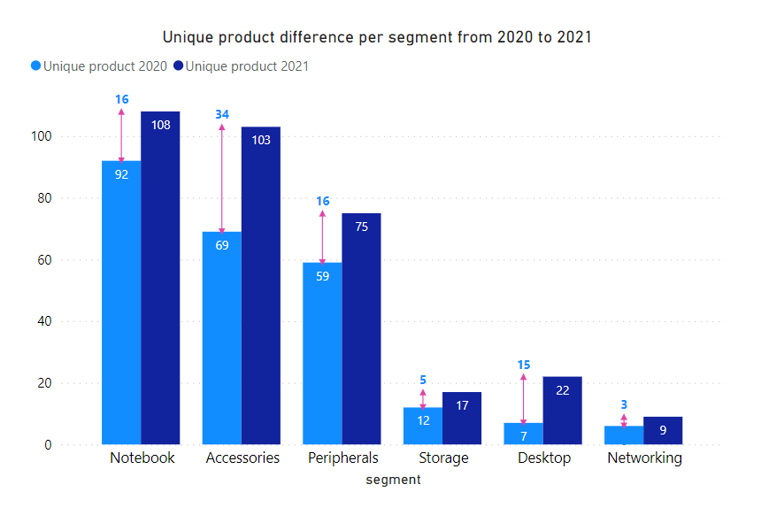
INSIGHTS:
1. Strategic Focus on Accessories:The introduction of 34 new accessory products underscores a strategic push to expand the segment, aligning with evolving consumer demands.
2. Production Variations: Slower growth in storage and networking production signals the need for optimization or strategic reassessment to better match production capacity with market dynamics or to explore avenues for stimulating growth in these segments.

Slide 13

5.Get the products that have the highest and lowest manufacturing costs. The final output should contain these fields:
product_code,
product,
manufacturing_cost

Slide 14
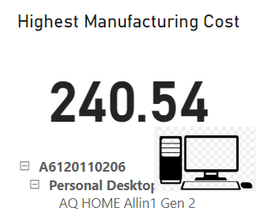
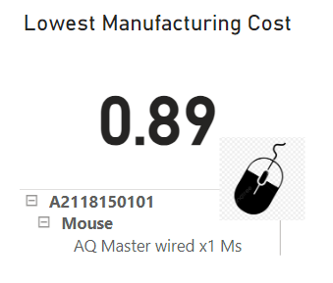

INSIGHTS:
Personal Desktop: AQ Home Allin1 Gen2 (Variant:Plus3) has the highest manufacturing cost..
Mouse: AQ Master wired x1 Ms (Variant:Standard1) has the lowest manufacturing cost.

Slide 15
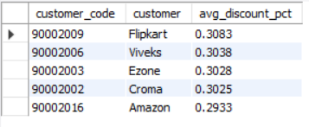
6.Generate a report which contains the top 5 customers who received an average high pre_invoice discount_pct for the fiscal year 2021 and in the Indian market. The final output contains these fields:
customer_code,
customer,
average_discount_percentage

Slide 16
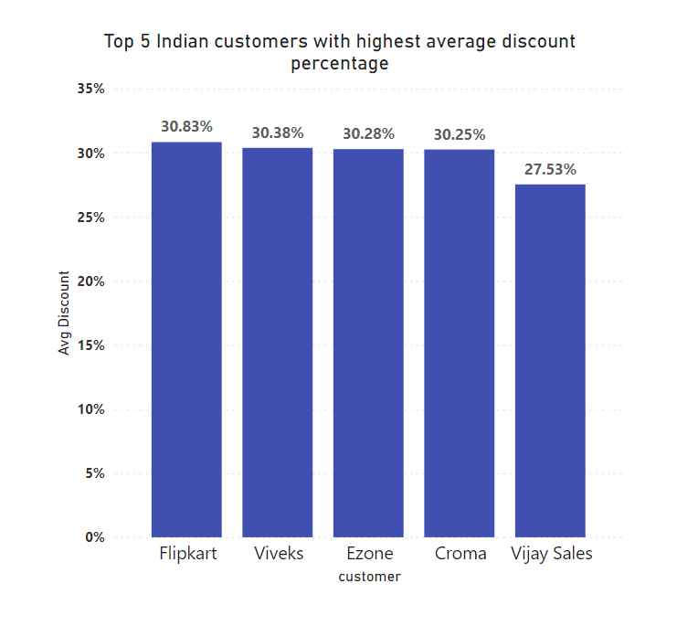
INSIGHTS:
1. Uniform Discount Strategy:The company's approach of offering nearly equal pre-invoice discount percentages to its top 5 customers suggests a consistent and balanced discounting strategy aimed at maintaining competitiveness across key accounts.
2. Market Positioning: While Flipkart receives the highest average pre-invoice discount, indicating its prominence in the Indian market.

Slide 17
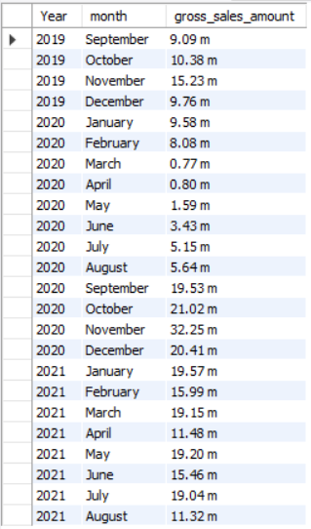
7.Get the complete report of the Gross sales amount for the customer “Atliq Exclusive” for each month. This analysis helps to get an idea of low and highperforming months and take strategic decisions. The final report contains these columns: Month,
Year,
Gross sales Amount

Slide 18
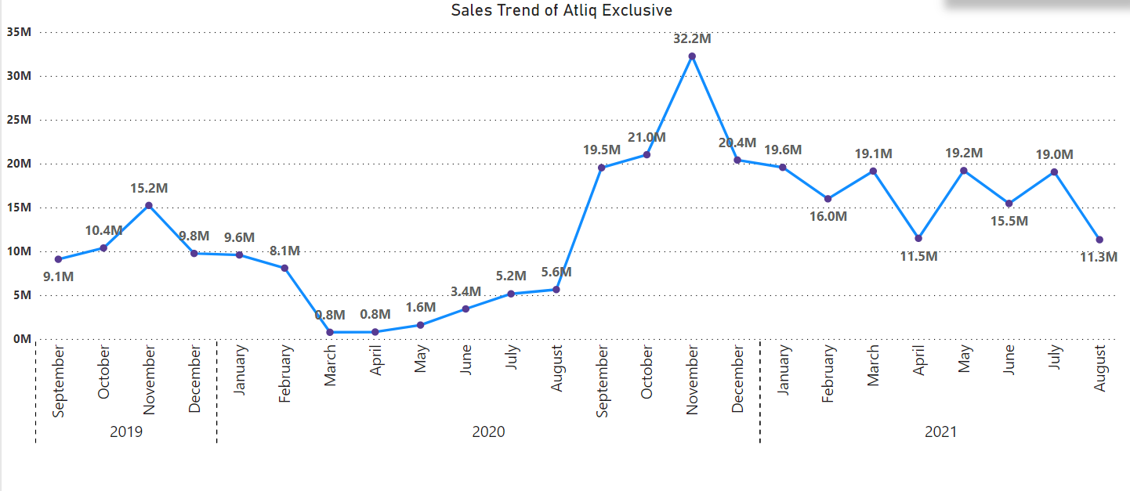
INSIGHTS:
1. COVID-19 Impact: March 2020 saw the lowest gross sales for Atliq Exclusive, reflecting the initial downturn attributed to the COVID-19 pandemic, while the subsequent months up to August also experienced suppressed sales due to pandemic-related challenges.
2.Resilient Recovery: Following August, there was a notable rebound in sales, culminating in November 2020 recording the highest sales figure for the period, indicating a swift recovery and resilience in the business despite the earlier pandemic-induced downturn.

Slide 19
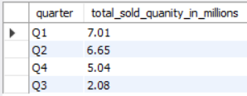
8.In which quarter of 2020, got the maximum total_sold_quantity? The final output contains these fields sorted by the total_sold_quantity:
Quarter,
total_sold_quantity

Slide 20
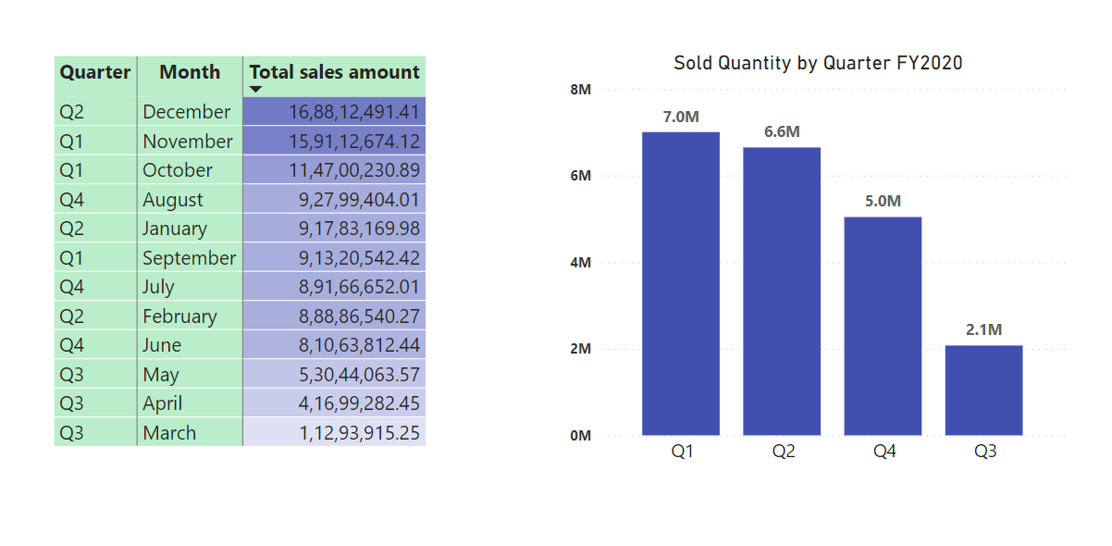
INSIGHTS:
1.COVID-19 Impact on Sales:Despite a dip in sales to 2.1 million units in Q3 FY 2020 (March-May), attributed to the peak of the pandemic, the company's early recovery in Q4 suggests resilience.
2.Education-Driven Demand:The surge in hardware sales, including desktops and notebooks, during Q4 FY 2020 coincides with the increased demand from students transitioning to online coursework, indicating a shift in consumer needs due to the pandemic.
3.Seasonal Sales Dynamics: Quarter 1 FY 2020 saw the highest overall units sold, accounting for 34% of the total, while the lowest sales occurred in Q3. Additionally, December and March marked the highest and lowest overall sold quantity respectively, reflecting seasonal variations in demand.

Slide 21

9.Which channel helped to bring more gross sales in the fiscal year 2021 and the percentage of contribution? The final output contains these fields:
Channel,
gross_sales_mln percentage

Slide 22
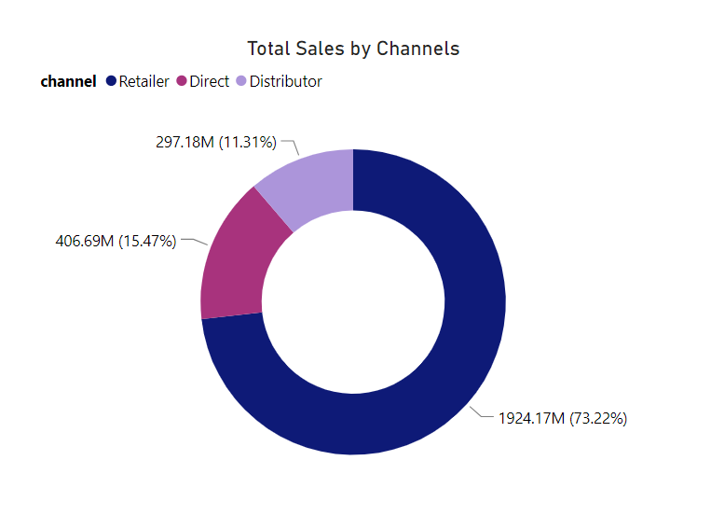
INSIGHTS:
1.Retail Dominance:Retailers emerged as the primary sales channel, contributing significantly with 75% of total sales and accounting for the highest contribution percentage of 73.22%, showcasing their pivotal role in driving company revenues.
2.Limited Distributor Impact: While distributors play a role, their contribution is comparatively smaller at 11.31%, indicating a lesser influence on overall sales compared to other channels, highlighting potential areas for channel optimization or expansion.

Slide 23
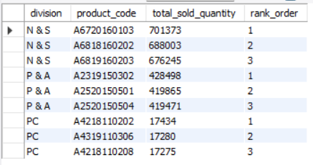
10.Get the Top 3 products in each division that have a high total_sold_quantity in the fiscal_year 2021? The final output contains these fields:
division,
product_code,
total_sold_quantity,
rank_order

Slide 24
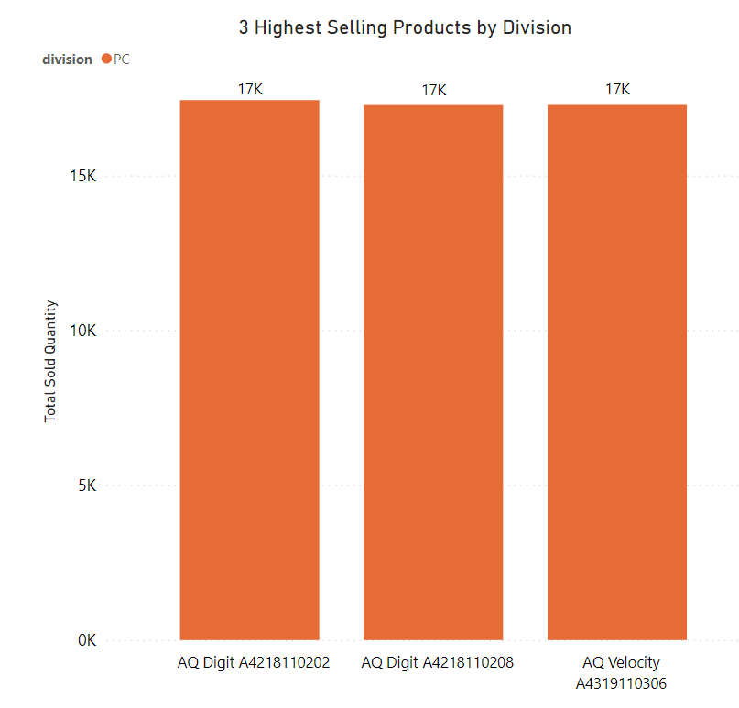
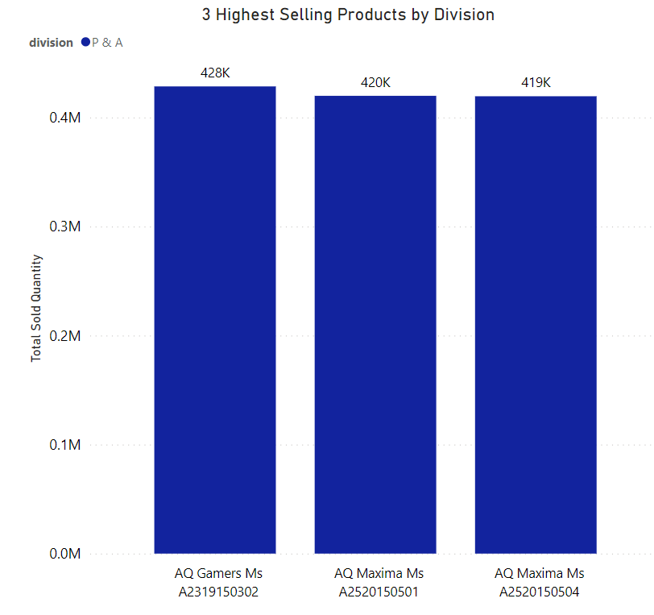
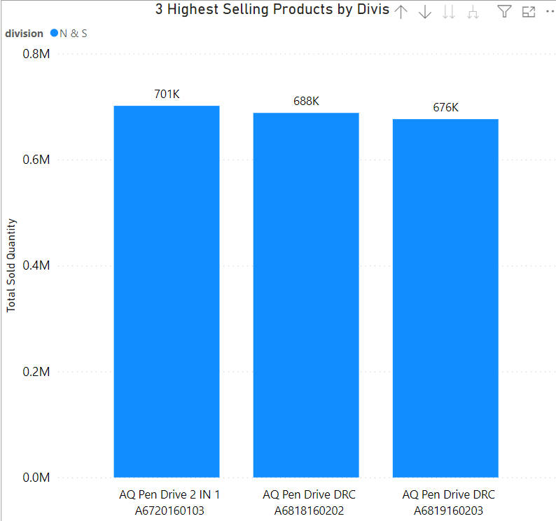
INSIGHTS:
1.Top Sellers by Division:Pen drives emerged as the top-selling products in the N&S division, totaling around 700,000 units, followed b0y mice in the P&A division, selling approximately 400,000 units, and personal laptops in the PC division, with sales reaching around 17,000 units.
2.Diverse Sales Volumes:Despite different product categories, sales volumes varied significantly across divisions, with pen drives dominating N&S, mice leading P&A, and personal laptops being the top sellers in PC, reflecting the diverse consumer preferences and market dynamics in each division.

Slide 25
THANK YOU

